Slide 1
CS 5683: Algorithms & Methods for Big Data Analytics Frequent Itemset Mining
Arunkumar Bagavathi
Department of Computer Science
Oklahoma State university

Slide 2
Market Basket Model
Supermarket (Walmart) shelf organization management – Market Basket Model:
Goal: Identify items that are bought together significantly by many customers
Approach: Process the sales data collected from barcode scanners to find dependencies among items
A classic example:
If someone buy eggs and diaper, then they will most likely buy beer
Do not be surprised if you find sixer and half rack near diaper!

Slide 3
Market Basket Model
A large set of items
(e.g.) Things sold in a supermarket
A large set of baskets
A basket is a small subset of items
(e.g.) Things one customer buys on one day
Discover association rules:
People who bought {x,y,z} also tend to buy {a,b}
Example applications:
Amazon
Netflix
INPUT
Basket | Items
1 | Bread, Coke, Milk
2 | Beer, Bread
3 | Beer, Coke, Diaper, Milk
4 | Beer, Bread, Diaper, Milk
5 | Coke, Diaper, Milk
OUTPUT
Discovered Rules:
{Milk} → {Coke}
{Eggs, Milk} → {Beer}

Slide 4
In General Terms
A general association (many-to-many mapping) between kinds of items
We ask connections/association between items not baskets
Items and Baskets are abstract
Items/baskets can be products/shopping basket
Items/baskets can be words/documents
Items/baskets can be basepairs/genes
Items/baskets can be drugs/patients

Slide 5
Applications - 1
Items = products/things; Baskets = set of products someone bought from the store in one trip
Supermarket basket: Supermarket chains store all customers shopping data to study what customer buys together
It tells how typical customer navigate in stores – allows them organize items that are most frequently bought together
Classic story of “diaper” and “beer”
Used to position “potato chips” near by “diaper” and “beer” to enhance the sales of “potato chips”
Analogy to:
Amazon’s “people who bought X also bought Y”
Netflix’s “people who watch A also watch B”

Slide 6
Applications - 2
Items = documents; Baskets = sentences in documents
Items that appear together too often could mean plagiarism
NOTE: Items do not always have to be “in” baskets
Items = drugs & side-effects; Baskets = patients
Used to detect combinations of drugs that result in side-effects
Caveat: Both presence and absence of an item need to be observed

Slide 7
Frequent Itemsets
Simplest task: Find sets of items that appear together “frequently” in baskets
Support of itemset I: Number of baskets containing all items in I
Often expressed in percentage (fraction of total number of baskets )
Given a support threshold ‘s’ then sets of items that appear in at least ‘s’ baskets are called frequent itemsets
TID | Items
1 | Bread, Coke, Milk
2 | Beer, Bread
3 | Beer, Coke, Diaper, Milk
4 | Beer, Bread, Diaper, Milk
5 | Coke, Diaper, Milk
Itemset: {Diaper, Milk} Support = 3

Slide 8
Example Frequent Itemsets
Items: {Milk, Diaper, Pepsi, Coke, Beer, Juice}
Support threshold = 3 baskets
B₁ = {m,b,p} B₄ = {c,j}
B₂ = {c,j,d} B₅ = {m,c,b,p,j}
B₃ = {p,j,m} B₆ = {m,p,b}
Frequent Itemsets: {m}, {p}, {c}, {b}, {j}, {m,p}, {c, j}, …

Slide 9
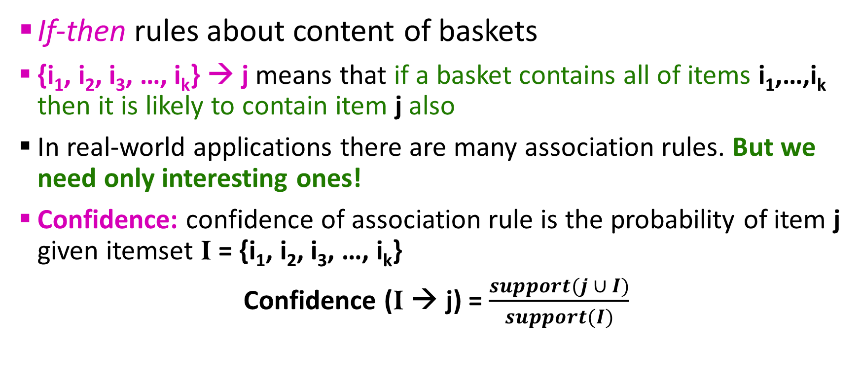
Association Rules
If-then rules about content of baskets
{i₁, i₂, i₃, …, i_{k}} → j means that if a basket contains all of items i₁,…,i_{k} then it is likely to contain item j also
In real-world applications there are many association rules. But we need only interesting ones!
Confidence: confidence of association rule is the probability of item j given itemset I = {i₁, i₂, i₃, …, i_{k}}
Confidence (I → j) = $\frac{support(j ∪ I)}{support(I)}$

Slide 10
Interesting Association Rules
Not all high confidence rules are interesting!
Example: The rule X → milk may have high confidence for many frequent itemsets X as milk is just purchased very often (independent of X). Thus the confidence will be high!
Interest of association rule I → j: Absolute difference between its confidence and fraction of baskets that contain j
Interest(I → j) = |conf(I → j) – Pr(j)|
Interesting rules are those with high interest value (usually above 0.5)

Slide 11
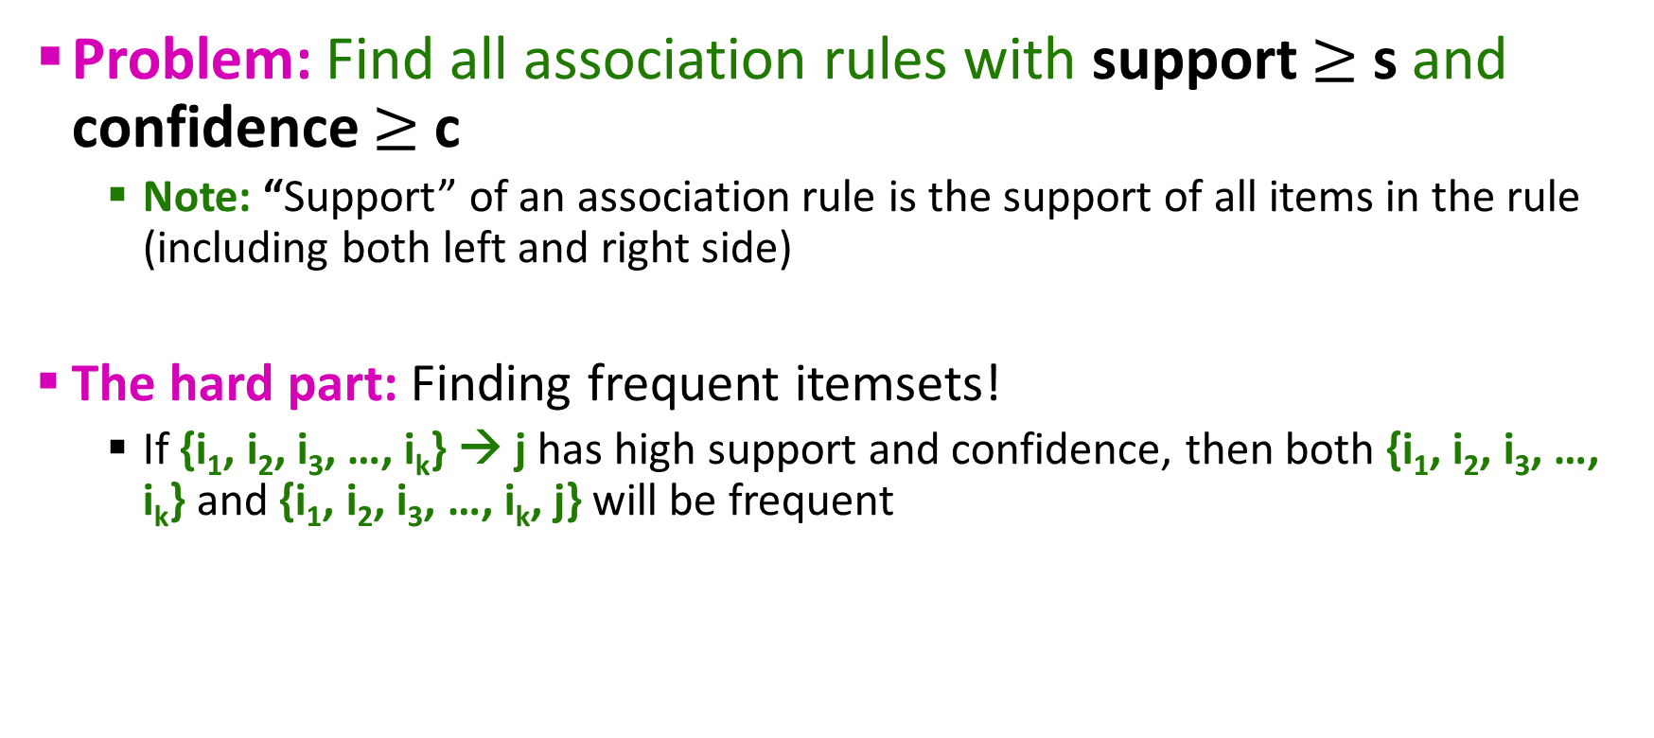
Association Rule Mining
Problem: Find all association rules with support $≥$ s and confidence $≥$ c
Note: “Support” of an association rule is the support of all items in the rule (including both left and right side)
The hard part: Finding frequent itemsets!
If {i₁, i₂, i₃, …, i_{k}} → j has high support and confidence, then both {i₁, i₂, i₃, …, i_{k}} and {i₁, i₂, i₃, …, i_{k}, j} will be frequent

Slide 12
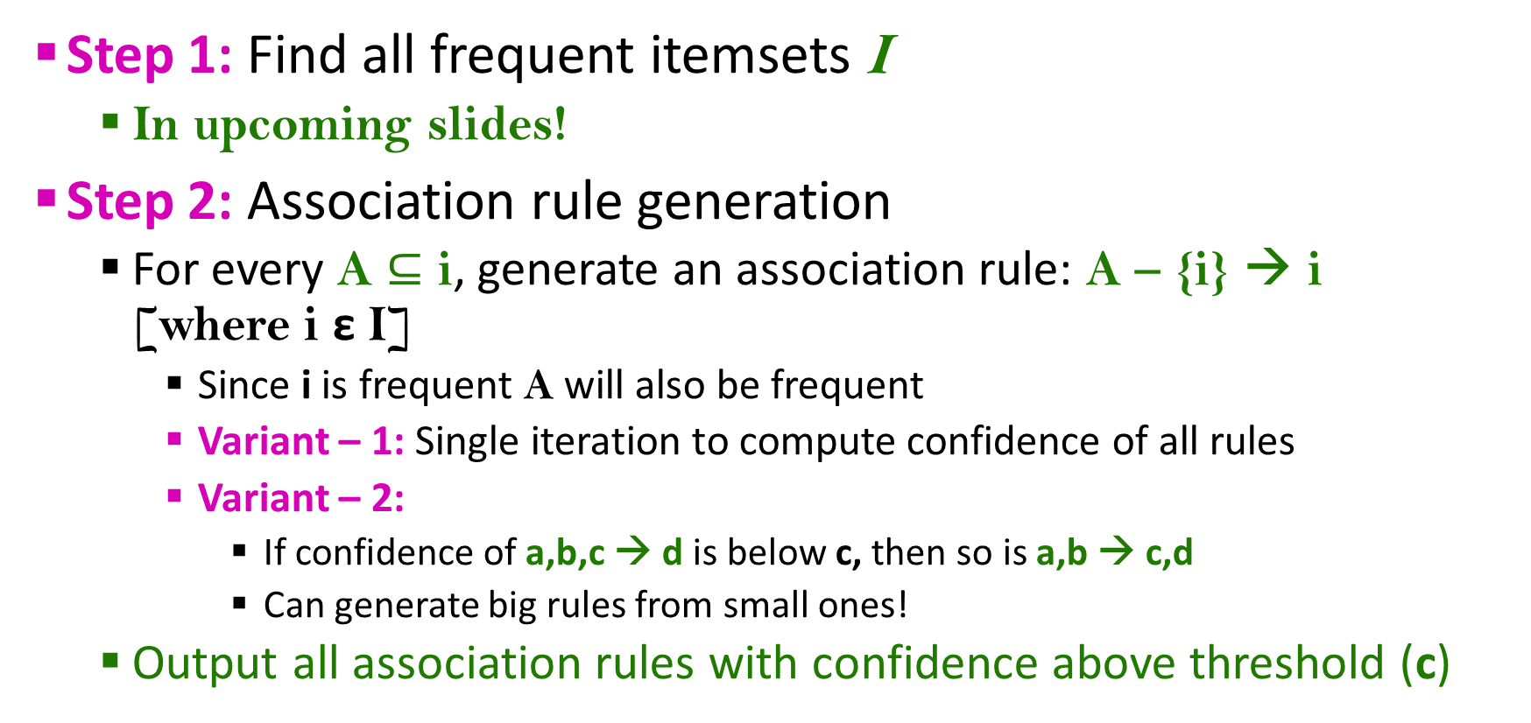
Association Rule Mining
Step 1: Find all frequent itemsets I
In upcoming slides!
Step 2: Association rule generation
For every A $⊆$ i, generate an association rule: A – {i} → i [where i ε I]
Since i is frequent A will also be frequent
Variant – 1: Single iteration to compute confidence of all rules
Variant – 2:
If confidence of a,b,c → d is below c, then so is a,b → c,d
Can generate big rules from small ones!
Output all association rules with confidence above threshold (c)

Slide 13
Example
B₁ = {m,b,p} B₄ = {c,j}
B₂ = {c,j,d} B₅ = {m,c,b,p,j}
B₃ = {p,j,m} B₆ = {m,p,b}
s = 3 and c = 0.8
Step – 1: Find frequent itemsets
{m,b}, {m,p}, {b,p}, {c, j}, {m, b, p}
Step – 2: Generate association rules
m → b: c = 0.75 X
b → p: c = 1
c →j: c = 1
j → c: c = 0.75 X
…
m,b → p: c = 1
m,p → b: c = 0.75 X
b,p →m: c = 1
m → b,p: c = 0.75 X
…

Slide 14
Finding Frequent Itemsets
Item
Item
Item
Item
Item
Item
Item
Item
Item
Item
Item
Item
Etc.
Typically data is kept in flat files – instead of databases
Stored on computer/server disk
Stored basket by basket
Each basket is small – but there are many baskets and many (k) items
Items are positive integers. Boundaries between baskets are -1
Expand each basket of items into pairs, triples, etc. as we read each basket
To generate all possible combinations of itemsets – we need to use nested loops for each basket!
To find frequent itemsets – we need to count itemsets. To count itemsets we need to enumerate them.

Slide 15
Computation Model
Item
Item
Item
Item
Item
Item
Item
Item
Item
Item
Item
Item
Etc.
The true cost of mining disk residing data is usually the number of disk I/Os
In practice, association rule algorithms read the data in passes
Each basket in one pass
Me measure the cost of an association rules extraction algorithm by measuring the number of passes it makes over the data

Slide 16
Another Bottleneck
Remember we need to enumerate itemsets!
For many frequent itemset mining algorithms, main-memory is the critical resource
We need to keep the count of pairs, triples, etc. as we read each basket
Such count should reside in memory for the entire running time of the algorithm
But, the number of itemsets we can count is limited by main-memory
Instead, counts can be stored to file(s)!
This will be a disaster!

Slide 17
Hardest Problem
Enumerating all combinations!
Let’s start with a simple step!
The hardest problem is often to be finding frequent item pairs
WHY? Freq. pairs are more common than freq. triples
WHY? The probability of being frequent drops exponentially with size

Slide 18
Finding Frequent Pairs
Approach:
We always generate all itemsets
But we only want to keep track of (count) those item that in the end turn out to be frequent
Scenario
Imagine we aim to identify frequent pairs
We need to enumerate all pairs of items from all baskets
BUT, rather than keeping a count for every pair, we hope to discard a lot of pairs and only keep track of the ones that will in the end turn out to be frequent

Slide 19
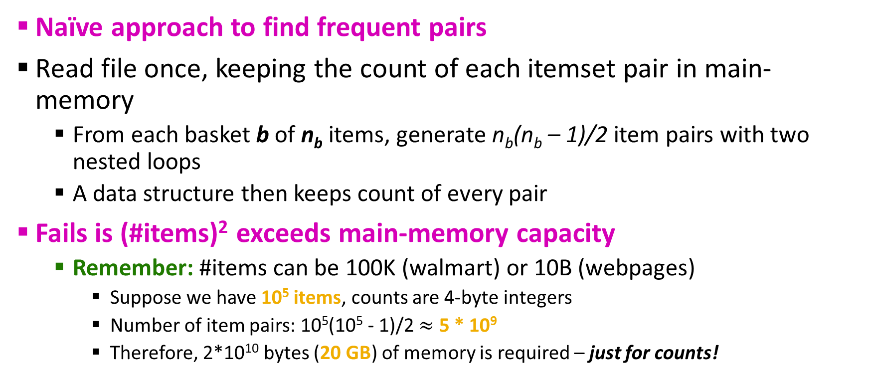
Naïve Algorithm
Naïve approach to find frequent pairs
Read file once, keeping the count of each itemset pair in main-memory
From each basket b of n_{b} items, generate n_{b}(n_{b} – 1)/2 item pairs with two nested loops
A data structure then keeps count of every pair
Fails is (#items)² exceeds main-memory capacity
Remember: #items can be 100K (walmart) or 10B (webpages)
Suppose we have 10⁵ items, counts are 4-byte integers
Number of item pairs: 10⁵(10⁵ - 1)/2 $≈$ 5 * 10⁹
Therefore, 2*10¹⁰ bytes (20 GB) of memory is required – just for counts!

Slide 20
Counting Pairs in Memory
Goals: Count the number of occurrences of each pair of items (i,j)
Approach 1: 2-D triangular matrix
Order items in the basket such that i < j always in an item-pair (i,j)
Approach 2: 1-D matrix (space efficient)
Store the count in a[k] for item-pair (i,j)
k = (i-1)(n – (i/2)) + j -1
Result of this stores the count in lexicographic order: First the count of {1,2}, {1,3}, {1, 4},…, {1, n} then the count of {2,3}, {2, 4}, … {2, n},…. down to {n-2, n-1}, {n-2,n}, {n-1,n}
What we do if we have too many item-pairs to fit in memory?
What about 3-itemsets, 4-itemsets, etc.?

Slide 21
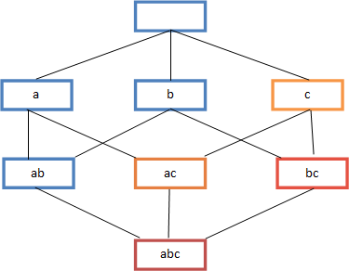
A-Priori Algorithm (1)
A-Priori limits the need for main-memory with its 2-pass approach
Key idea: monotonicity
If a set of items I appears atleast s times, so does every subset J of I
Contrapositive for pairs:
If items i does not appear in s baskets, then no pair including i can appear in s baskets
So, how does A-Priori algorithm finds freq. Itemsets?

Slide 22
A-Priori Algorithm (2)
Pass-1: Read baskets and count the # of occurrences of each individual item in main-memory
Requires only memory proportional to # items
Remove items that does not satisfy count ≥ s from memory as they are not frequent
Pass-2: Read baskets again and keep track of the count of only pairs where both items are frequent (from Pass 1)
Required memory: square of the number of frequent items (not the square of total number of items) + number of frequent items (to know which item to count)

Slide 23
A-Priori – Main Memory Picture
Item counts
Frequent items
Counts of pairs of frequent items (candidate pairs)
Main memory
Pass 1
Pass 2
Green box represents the amount of available main memory. Smaller boxes represent how the memory is used.

Slide 24
Finding Frequent Triples, etc.
For each k, we construct two sets of k-tuples (itemsets of size k):
C_{k} = candidate k-tuples = combined itemsets from pass k-1 that might be frequent (support ≥ s)
L_{k} = truly frequent k-tuples
Count the items
All pairs of items from L₁
Count the pairs
All items
In the next slide
C₁
Filter
L₁
Construct
C₂
Filter
L₂
Construct
C₃

Slide 25
Example
Hypothetical steps of the A-Priori algorithm
C₁ = { {b} {c} {j} {m} {n} {p} }
Count the support of itemsets in C₁
Prune non-frequent. We get: L₁ = { b, c, j, m }
Generate C₂ = { {b,c} {b,j} {b,m} {c,j} {c,m} {j,m} }
Count the support of itemsets in C₂
Prune non-frequent. L₂ = { {b,m} {b,c} {c,m} {c,j} }
Generate C₃ = { {b,c,m} {b,c,j} {b,m,j} {c,m,j} } ➔
Count the support of itemsets in C₃
Prune non-frequent. L₃ = { {b,c,m} }
We generate new candidate itemsets C_{k} from L_{k-1} and L₁.
One can be more careful with candidate generation. For example, in C₃ we know {b,m,j} cannot be frequent since {m,j} is not frequent

Slide 26

Questions???

Slide 27
Acknowledgements
Some contents of these slides are motivated by materials from:
Dr. Srinivas Akella – UNC Charlotte
Spark: The Definitive Guide textbook by Chambers, and Zaharia
Learning Spark: Lightning-Fast Data Analysis textbook by Karau, Konwinski, Wendall, and Zaharia
spark.apache.org
Zaharia, Matei, et al. "Spark: Cluster computing with working sets." HotCloud 10.10-10 (2010): 95. (Paper)
Zaharia, Matei, et al. "Resilient distributed datasets: A fault-tolerant abstraction for in-memory cluster computing." Presented as part of the 9th {USENIX} Symposium on Networked Systems Design and Implementation ({NSDI} 12). 2012. (Paper)

